Slide 1
Unit : 2 Basic Docker operations. : Create a Docker-hub account, Pushing the Docker to container-hub,

Slide 2
Docker Hub
It simplifies development with a powerful container registry for :
storing , managing and sharing Docker images.
By integrating seamlessly with your tools,
it enhances productivity and
ensures reliable deployment, distribution.
access to containerized applications.
It also provides developers with pre-built images and assets to speed up development workflows.

Slide 3
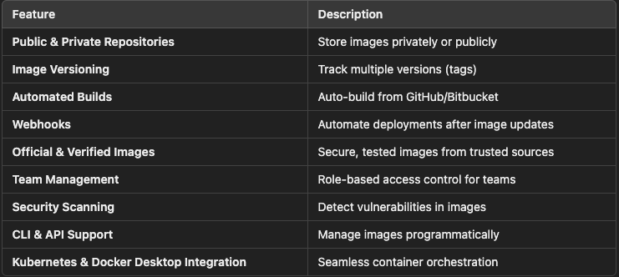
Features of Docker Hub

Slide 4
Create a Docker-hub account
Go to Docker Hub.
Click on "Sign Up".
Enter your username, email, and password.
Click "Sign Up" and verify your email.
Log in to Docker Hub and navigate to the Repositories tab.

Slide 5
Create first repository
Open Docker Desktop.
Click on your profile icon (top-right corner).
Click "Docker Hub" – this will open your Docker Hub account in a browser.
In Docker Hub, click "Repositories" (on the left sidebar).
Click "Create Repository".
Visibility: Choose Public (free) or Private (paid plan)
Click "Create".
Your repository is now ready for storing images!

Slide 6
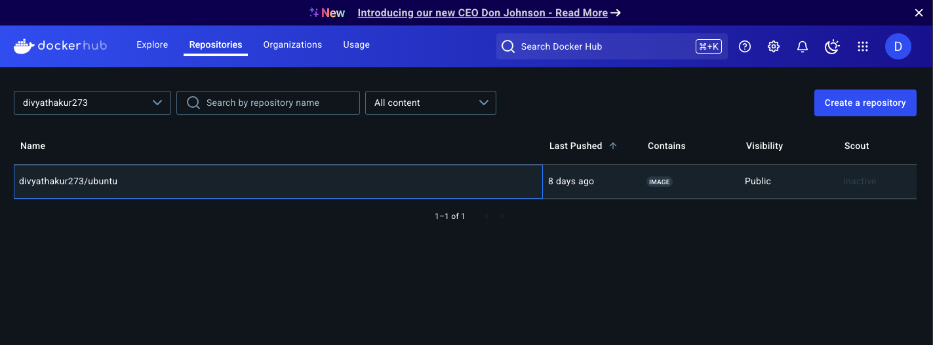
Below is the docker hub repository view

Slide 7
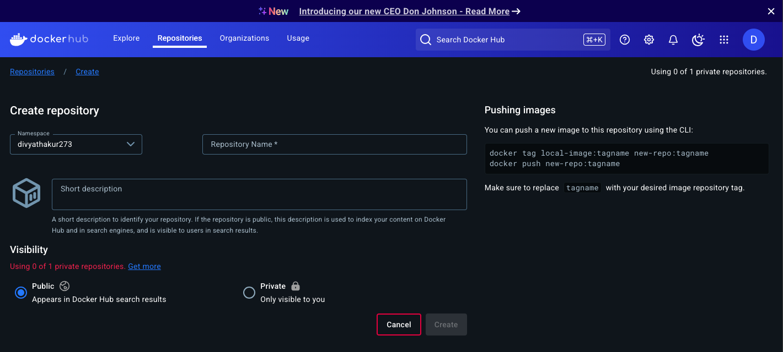
Choose btw public & private repo

Slide 8
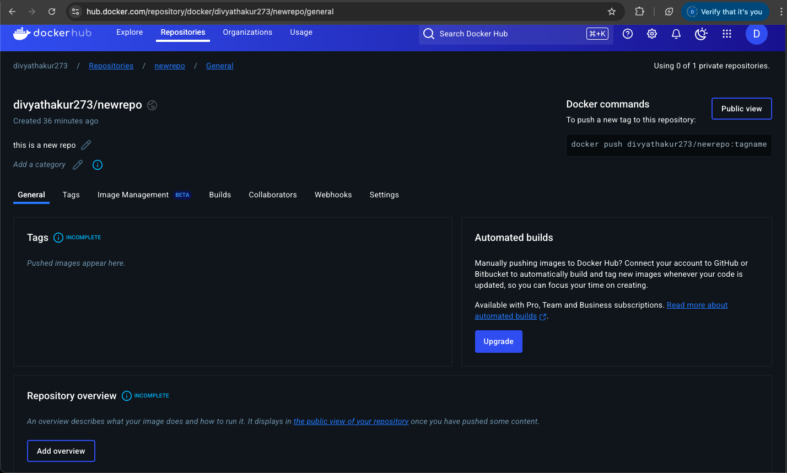
Contents inside repo

Slide 9
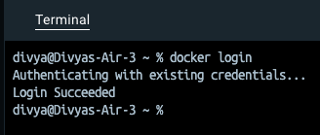
List Your Own Docker Hub Repositories in the Docker CLI
Step 1: Log In to Docker Hub
command : docker login
Enter your Docker Hub username & password when prompted.

Slide 10

Step 2 : Use Docker Hub API
After logging in, use the Docker Hub API to list your repositories:
curl -s https://hub.docker.com/v2/repositories/<your-docker-id>/ | jq '.results[].name'
eg:
curl -s https://hub.docker.com/v2/repositories/divyathakur273/ | jq '.results[].name'

Slide 11
Install jq Based on Your OS
For macOS (Homebrew):
brew install jq
For Ubuntu/Debian:
sudo apt update && sudo apt install jq -y
For Windows (Using Chocolatey):
choco install jq
https://jqlang.org/ : download using this link
: move it to the directory in your system path
windows\System32\
verify in cl : jq --version

Slide 12
List All Tags for a Specific Repository
curl -s https://hub.docker.com/v2/repositories/mydockeruser/my-first-repo/tags/ | jq '.results[].name'

Slide 13
Push a Docker Image to Docker Hub
Step 1: Log in to Docker Hub via CLI
Step 2: Pull a new image
Step 3 : Run the image
Step 4 : Make Changes Inside the Container
Step 5 : Save Changes as a New Image
Step 6 : Tag the New Image for Docker Hub
Step 7 : Push the Image to Docker Hub

Slide 14
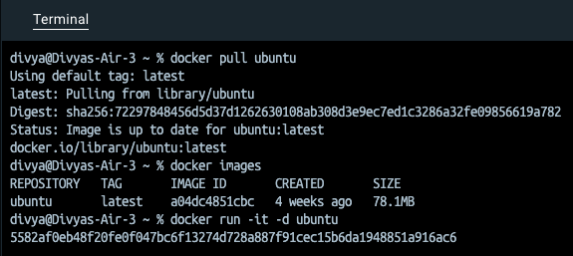
Practical

Slide 15
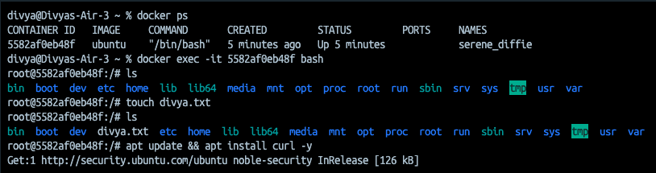
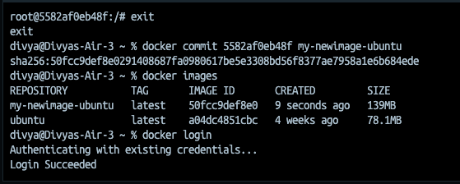

Slide 16
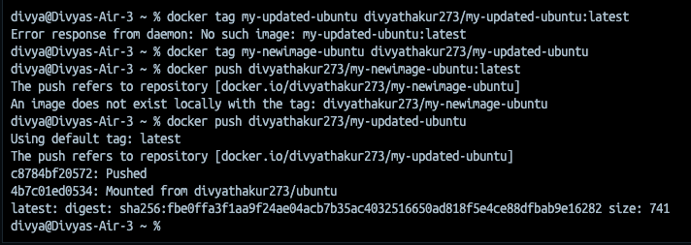

Slide 17
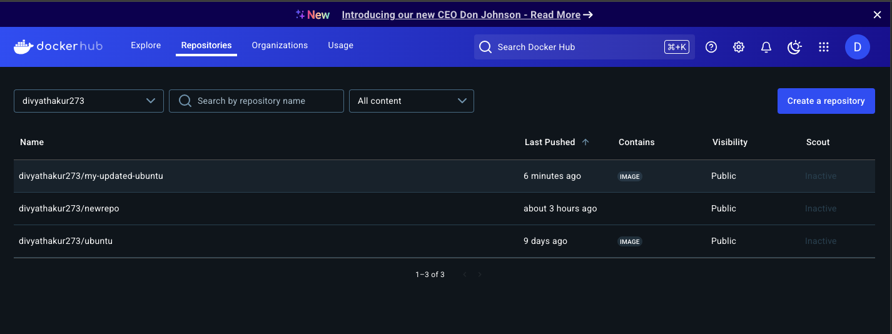
Output

Slide 18
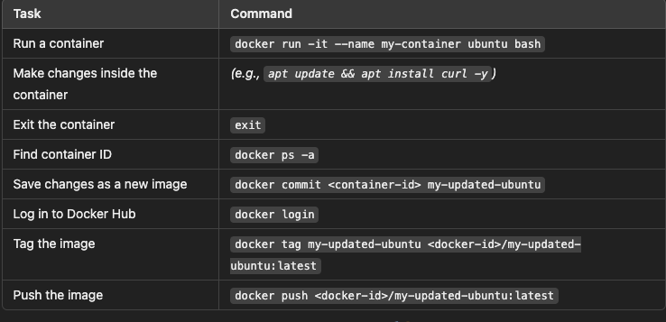
Summary

